Slide 1

TOPIC:
CLASS IMBALANCE AND FEW-SHOT LEARNING
WITH OBJECT DETECTION ALGORITHM YOLO3
Notes:
Welcome to my presentation about class imbalance and few-shot learning with object detection algorithm YOLO3.

Slide 2
Table of Contents
Background
YOLO3 algorithms details
Data, Class Imbalance and Few-Shot learning
Results
Conclusion and Discussions
Notes:
The presentation will have 5 parts: Background….

Slide 3

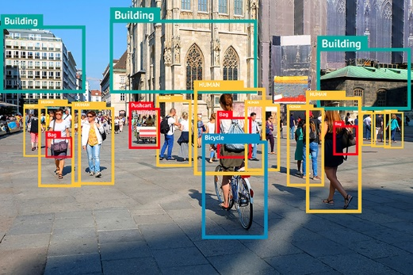
1. Background
Computer Vision:
- An area of artificial intelligence which enable computers to derive information from images
- Two essential technologies: deep learning and convolutional neural network (CNN)
Object detection:
- A branch of computer vision: identify object types and their locations in images
- Highly practical fields: autonomous driving, video surveillance, anomaly detection
- Emerged since 2000 due to deep learning and power of GPU
Notes:
So we will jump into the first parts to get general understanding about computer vision and object detection.
Computer vision is an area of artificial intelligence which enable computers to derive insightful information from digital images
A branch of computer vision is object detection which detects locations of objects and their labels in images. Object detection is the highly practical field and used in various applications such as autonomous driving, video surveillance
anomaly detection

Slide 4
1. Background
Object Detection
- Two categories of algorithms:
+ One stage: YOLO , SSD (2016), RetinaNet(2017), YOLO3 (2018), YOLO5(2020), YOLOR(2021)
+ Two stages: RCNN, Fast RCNN, Faster RCNN
YOLO3 developed by Joseph Redmon in 2018: Main focus of this dissertation together with class imbalance and few-shot learning.
Notes:
There are two main categories of algorithms in object detection
One stage and two stages object detection
In this project we will use YOLO3 algorithm to work with class imbalance and few-shot learning

Slide 5
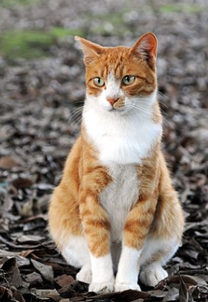
2. YOLO algorithms details
Images are divided into NxN grid then pass through a CNN network. This network will detect objects in each cell
- Each cell go through CNN will output three vector objects : ( t_{x}, t_{y}, t_{w}, t_{h}, p_{c} , C₁,…,C_{k} )
( t_{x}, t_{y}, t_{w}, t_{h}, p_{c} , C₁,…,C_{k} )
CNN
NxNx3x(5+nb_classes)
Image pre-processing unit
NxN
List of objects in images
Output processing unit
t_{x}, t_{y} : center coordinates of object
t_{w}, t_{h} : width and height of object
P_{c} : probability that an object exist in the cell
C₁, C₂,…, C_{k}: probability that detected object is class 1,…, class k
Notes:
We move to the next part to get more details about YOLO3. First, we will examine how it work in general.
When an image go though YOLO3, it first go through an image preprocessing unit then go though CNN network, and finally pass through output processing unit. It will output a list of detected object in the image.
It is noted that the image we got after preprocessing unit is divided into NxN grid, each cell when go though CNN will output three vectors size of (5+nb_classes)
T_{x}, t_{y}…

Slide 6
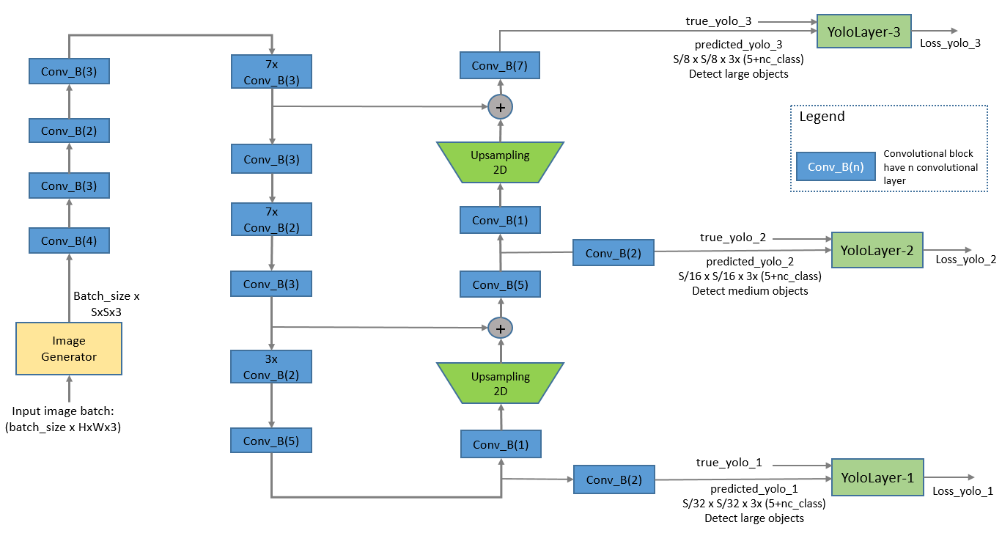
2. YOLO algorithms details
Details of image pre-processing unit and CNN
Loss calculation: serving for training process
Image pre-processing unit and CNN
Notes:
This diagram depict details of preprocessing unit and CNN network.
CNN network has multiple convolutional block, the number inside bracket indicate number of convolutional layers
We have three outputs from CNN network represent for three layers in YOLO3, these outputs are used to calculate loss during training process

Slide 7
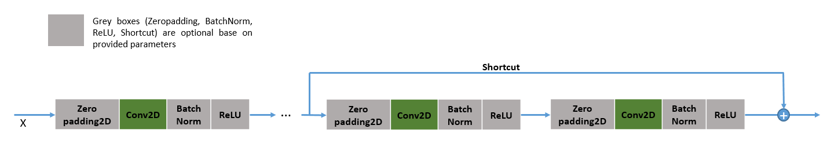
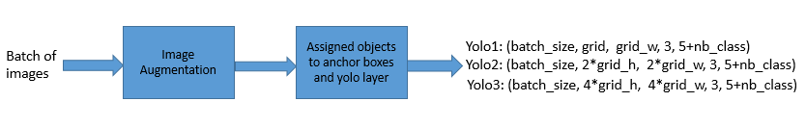
2. YOLO algorithms details
Details of image pre-processing unit and CNN
Convolutional Block details:
Generator unit: Adjust size of image, augment images and assign objects to YOLO layer
Notes:
This is detail for convolutional block, it have several convolutional layers, there is a short cut connection between the two last layers.
The generator unit will augment image and assign objects to anchor boxes and yolo layer

Slide 8
2. YOLO algorithms details
Output processing unit details:
Output processing unit
Decode_netout:
- Calculating objectness score
- Removing boxes with objectness score
which is less than 0.5
- Returning a list of boundbox object
(x_{min}, y_{min}, x_{max}, y_{max}, objectness, label)
Non_max Suppression:
Removing duplicated/overlap bounding boxes to ensure that each object is detected only one.
Notes:
Next, we will look at output processing unit, it has three blocks Decode_netout, Correct Yolo box and Non_max suppression
Some functions of Decode_netout
Non_max suppression

Slide 9
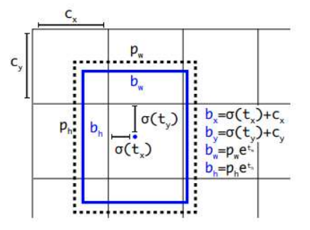
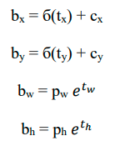
2. YOLO algorithms details
Relations between vector ( t_{x}, t_{y}, t_{w}, t_{h}) and coordinates of objects are represented by following formulas:
b_{x}, b_{y} : centered coordinates of bounding box on (0, N) scale
b_{w}, b_{h}: width and height of bounding box on standardized image scale.
p_{w}, p_{h}: width and height of assigned anchor box
б: sigmoid function
sigmoid(x)= 1/(1+exp(-x))
NxN grid
Notes:
Here we have some transformation on output of CNN network which are used to calculate loss later

Slide 10

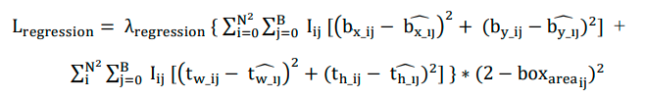
2. YOLO algorithms details
Loss function has three components: Classification loss, Regression Loss, Confidence Loss
Classification Loss penalize for incorrect classification:
Regression loss penalize for the difference between predicted coordinate and actual coordinate of objects
Notes:
Now, we discuss about the loss function. Loss function of YOLO3 have three components
Classification loss
Regression loss

Slide 11

2. YOLO algorithms details
Confidence loss penalizes for difference between predicted and actual confidence(actual confidence is one when an object is present, otherwise zero)
Total loss:
N, B: grid size and number of anchor boxes per cell, B =3 for YOLO3
b_{x_ij}, b_{y_ij}: center coordinates of bounding box at cell i for anchor box j
t_{x_ij}, t_{y_ij}: the width and height of the bounding box at cell I, anchor box j
I_{ij}: equal to 1 if an object exist in cell I and anchor j, otherwise equal to 0
p_{groundtruth}: predicted probability of groundtruth label
Notes:
Confidence loss: penalize for difference between predicted and actual confidence

Slide 12
3. Data, Class Imbalance and Few-Shot learning
In machine learning and computer vision both data quality and quantity has impacts to performance of models. We investigate two common issues: class imbalance and few-shot learning:
Class imbalance:
- Some classes have dominant representation in the dataset while others have much lower.
- Solution: collecting more data for under-represented classes, down- sampling, up-sampling, generate synthetic data
Few-shot learning:
- Situations that we have only a limited number of samples for training
- Reason: It is difficult to collect more data or it is high cost to gather data
- More popular in classification problems but object detection also get the attention recently
Notes:
Ok, we move to the third part Data, class imbalance and few-shot learning
In supervised learning, both data quality and quantify affect to performance of model. We will investigate two common issues: class imbalance, few-shot learning
Class imbalance happens when one or more classes have dominant representation in the dataset, while other classes have much lower representation
While few-shot learning is the technique to deal with situations that we have only limited data for training
the reasons for that could be data is not available or it is difficult to collect data, constraint by processing time

Slide 13
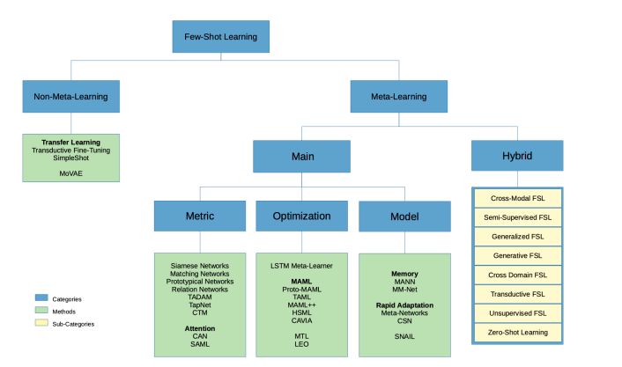
3. Data, Class Imbalance and Few-Shot learning
Approaches to few-shot learning
We stick with YOLO3 then “Generative FSL” will be used in this project.
Notes:
The diagram show different approaches on few-shot learning problem
We will go with generative few shot learning technique, more specifically , we use image augmentation technique to deal with lack of training data
And this is also method to deal with class imbalance.

Slide 14
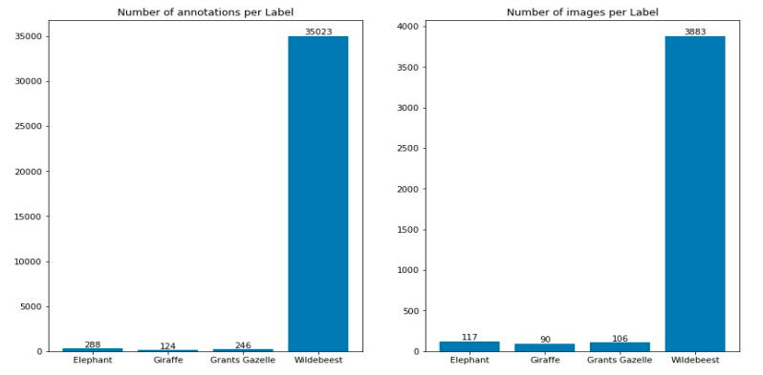
3. Data, Class Imbalance and Few-Shot learning
Data used for the project
Subset of Camera trap dataset:
4 classes
Multiple objects in one image
Diversity of object sizes:
large, medium and many
small objects
High resolution: 2592x1944
or 3264x2448
- Highly imbalance
Notes:
Data used for the project is a subset of Cameratrap dataset. It has 4 classes Elephant, Giraffe, Grants Gazelle and Wildebeest. The dataset is highly imbalanced, the predominant class is Wildebeest.

Slide 15
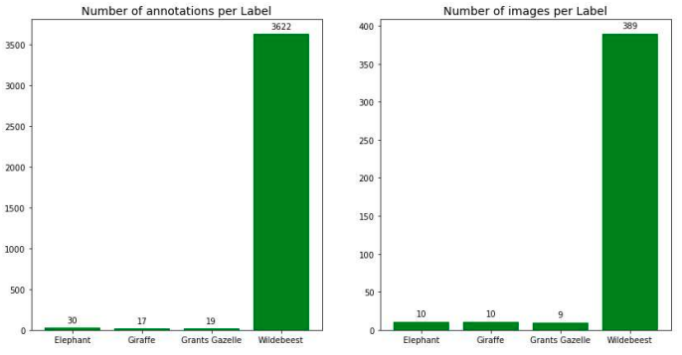
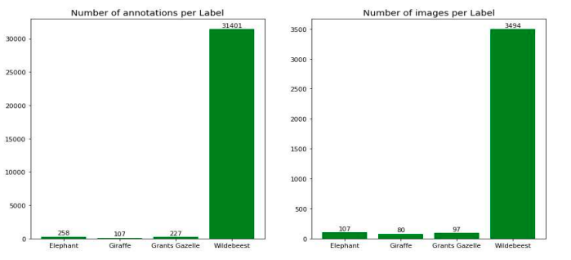
3. Data, Class Imbalance and Few-Shot learning
Train and test sets are split into one to nine ratio
Class imbalance still remains in training and test set
Data distribution - training set
Data distribution - test set
Notes:
We split dataset into train and test set follow ratio 1:9, we keep 90% data for test set so that when we validate model on test set we have high confidence about the result.

Slide 16
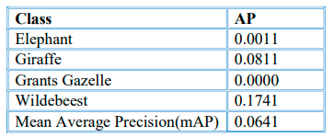
4. Results
Class imbalance:
Trained model and evaluate it on test set, the results is surprised poor. Strongest signal is at Wildebeest class, the dominant class in the dataset
This poor performance is caused by strong class imbalanced. We use image augmentation technique to address this issue.
Using relative coordinates to the width and height of images, we crop 48 images of each image in training set. Locations of cropped images are identified by vector (x₁, y₁, x₂, y₂):
(i/20, 0, 1 1), (0, 0, 1-1.2*(8-i)/20, 1), (i/17, i/25, 1, 1), (0, 0, 1-(8-i)/20, 1-(8-i)/25), (i/30, i/35, 1-(8-i)/30, 1-(8-i)/35) , (i/20, i/20, i/20+0.5, i/20+0.5), for i in {0, 1, 2, 3, 4 ,5 ,6, 7}
Notes:
So, here is the result. When we train model on training dataset and validate the model on the test set, her is the result. Very poor performance, the most significant result is on Wildebeest.
For each image contain Elephant, Giraffe or Grants Gazelle we crop 48 new images at different locations. Here is position we crop

Slide 17
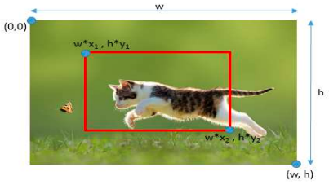
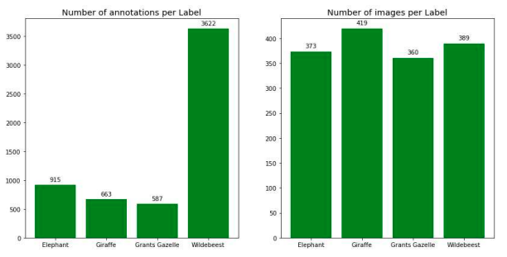
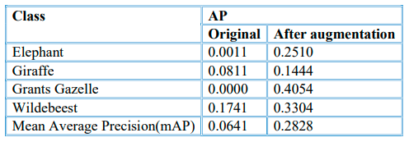
4. Results
Class imbalance:
New training set is more balanced in number of images per class. Number of annotations per label also improves. Model performance improve from 0.06 to 0.28mAP
Notes:
Example of cropped image
New training set is more balance
Result is better

Slide 18
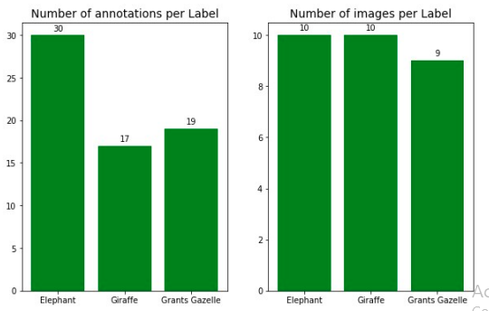
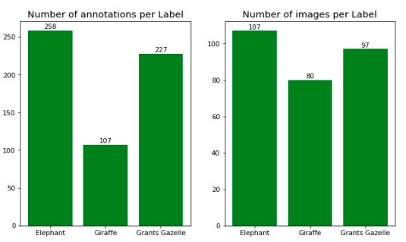
4. Results
Few-shot learning:
The same data in class imbalance but remove Wildebeest class. Number of images per class in training set is limited at 10.
Data distribution in training set
Data distribution in test set
Notes:
Now, let us examine result on few-shot learning
The data for this part is get from class imbalance case by removing class”Wildebeest”
It is balanced and no more than 10 images per class, less than 30 annotations for each class. We still keep 90% of data for testing set.

Slide 19
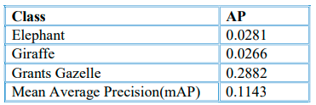
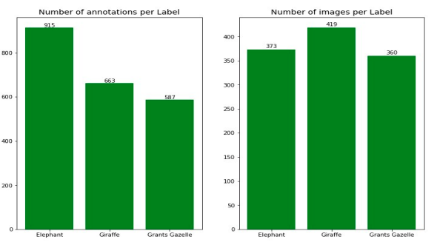
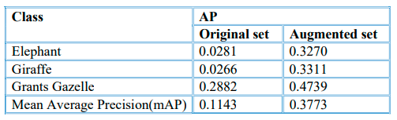
4. Results
Few-shot learning:
Training model and evaluate it on test set, we get a result at 0.114 mAP
Using the same image augmentation technique in class imbalance class to address this issue. The performance raise from just at 0.11mAP to 0.38mAP
Notes:
Training model and validate on test set, the result is quite poor.
Apply the same augmentation technique in the class imbalance case and train model again
Dataset is larger, and results also improve significantly to 0.377

Slide 20
5. Conclusion and Discussions
Conclusion:
Image augmentation is simple but effective to deal with both class imbalance and few-shot learning. This technique boosts the performance of the model from just 0.06 to 0.28mAP for class imbalance data and from 0.11 to 0.37mAP.
Training time and computational cost also raise significantly when use this method.
Limitation:
YOLO3 only predicts up to three objects in the same cell.
Two objects are assigned to the same anchor box then only one is detected
Future work:
Research newer models: YOLO4, YOLO5, YOLO6
Generative Adversarial Network (GANs) for generating new images
Meta-learning algorithms for Few-Shot learning: Siamese Networks, Matching Networks, Meta-Networks, Cross Domain FSL…
Notes:
We can conclude that when data is limited or unbalanced the performance of YOLO3 trained on that data could be negligible and image augmentation seem a simple but effectively to address these issues.
The performance rise from 0.06 to 0.28mAp for class imbalance case and from 0.11 to 0.37mAP for limited data sample case.
YOLO3 have some limitations, first it only predict up to three objects in the same cell
In case two objects are assigned to the same ancho box then only one detected
There are a lot of content and I can not cover detail everything here, so if you have any question, please feel free to share. Thank you for your listening

